Slide 1
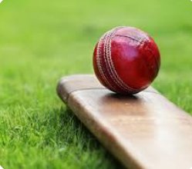
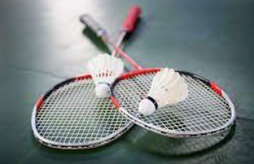
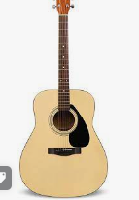
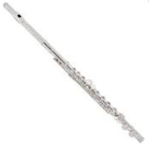
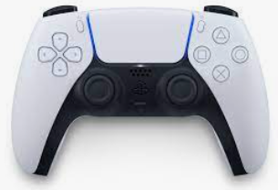
Personal Intro and Work Ex Benefits
Hobbies
Sports
Gaming
Music
Benefits
Improved my Teamwork and Communication
Helped me understand more about what I want to do in
the future

Slide 2
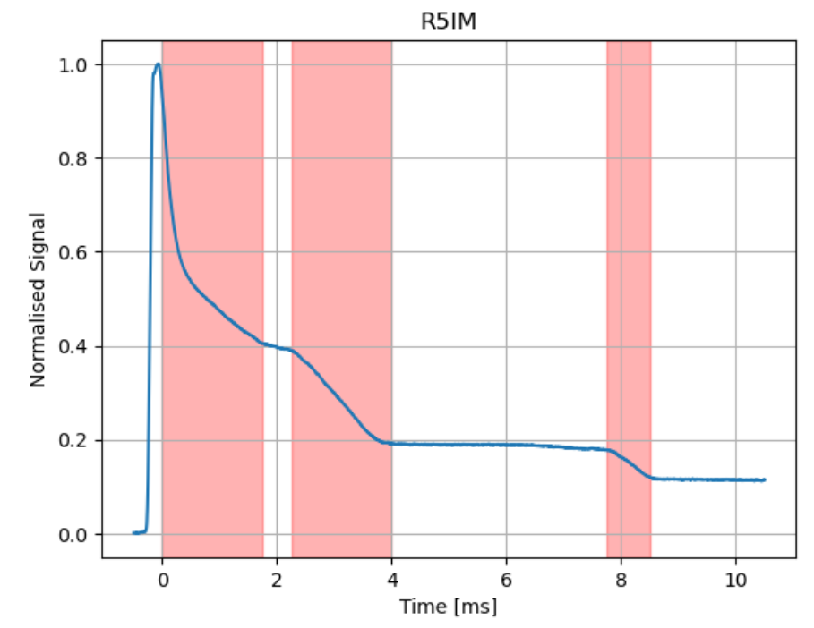
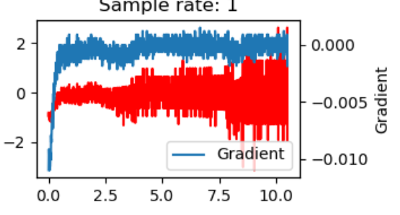
Stage 1 Project: Loss Finders
My Tasks
Documentation of code
Testing
What I learnt
Much harder than I previously thought
Importance of teamwork

Slide 3
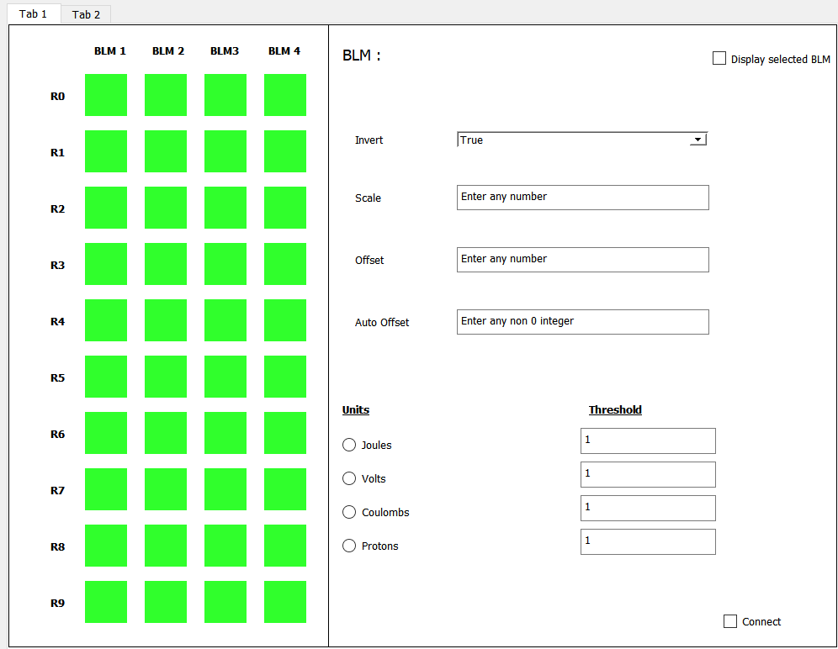
Stage 2 Project: LED Display
My Tasks
Designing the GUI
Creating the GUI
Implementing the GUI into python
What I learnt
Importance of non-coding based tasks

